Slide 1
Human Resources Presentation
Preservice training 2024

Slide 2
PAYCO HCM

Slide 3
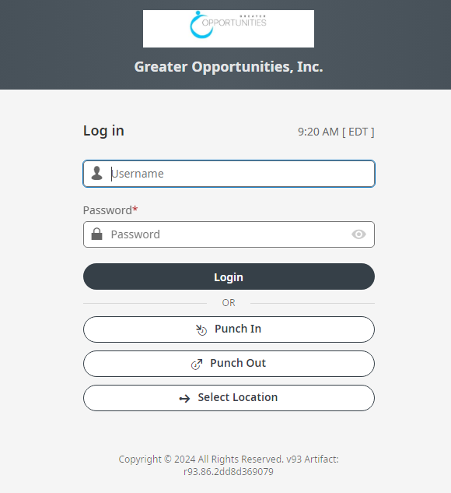
Punching In & Out and Logging In to payco https://secure.entertimeonline.com/ta/OPPC.clock
Enter your Username and Password and click Punch In or Punch Out or Login to your payco.

Slide 4
Where do you go to locate important Company Documents?

Slide 5
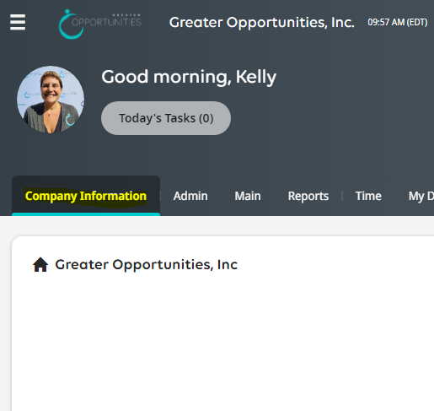
Company Information!!

Slide 6
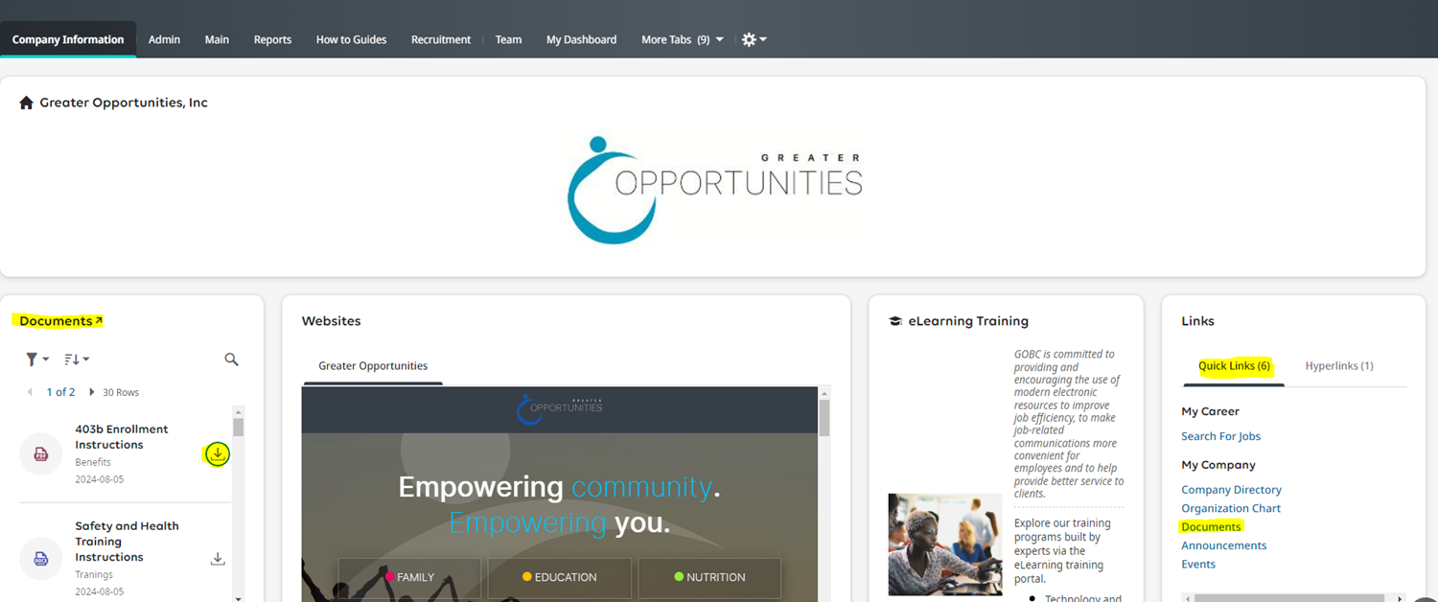
Documents
Download documents
Search

Slide 7
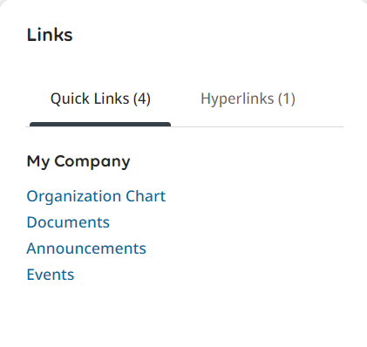
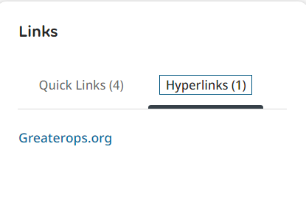
My Company Links
Click on any of the Quick links to review company information
Click on hyperlinks to go directly to our website

Slide 8
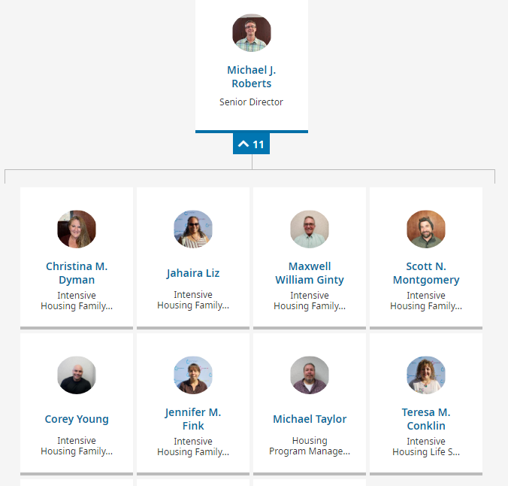
Organization chart based on your team and position

Slide 9
Which screens show your personal information and settings?

Slide 10
Start
My Info
Main Screen
This is the second tab on the home screen

Slide 11
Start Widget
You will see My Info and settings

Slide 12
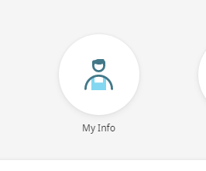
What information links can you access through the “My Info” widget?

Slide 13
My Info – This section contains links to your personal information:
My Profile – view all your personal information.
Current Timesheet – View the current pay periods timesheet.
Historical Timesheets – view all your historical timesheets.
Request Time Off – request time off, there are further instructions on page 5.
Time off History/Time Off Calendar – show time off already requested and approved or used.
My Pay Statements/My W2s – all your pay

Slide 14
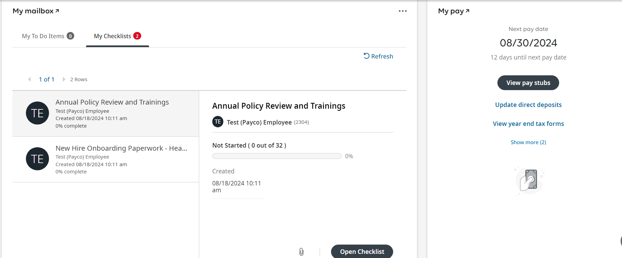
My Mailbox and MY Pay Main page Includes all To-Do items, Checklists, and My Pay Information

Slide 15
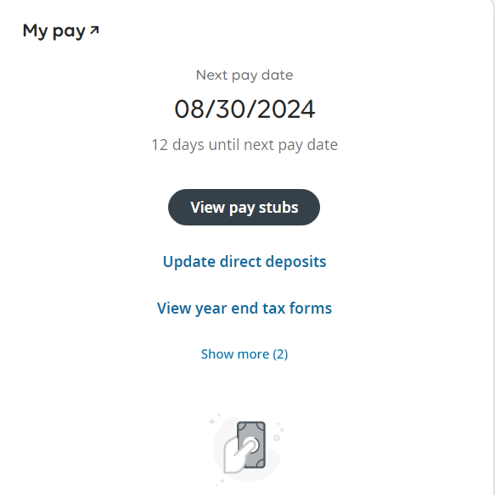
Viewing Pay Statements
In the ”My Pay ”widget you can see a countdown until your next pay where do you click to see your last 3 pay statements?
Notes:
Click on 3 lines upper left hand corner, type in “direct deposit”, you can edit, stop, or add new direct deposit

Slide 16
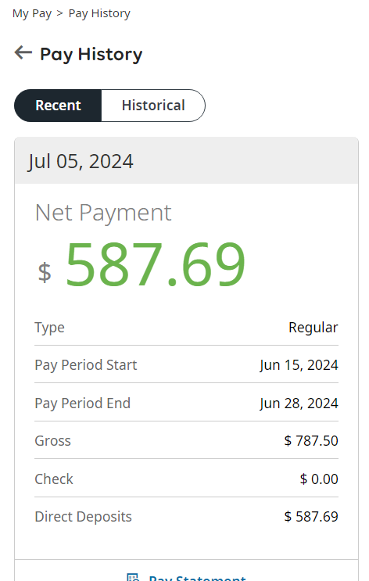
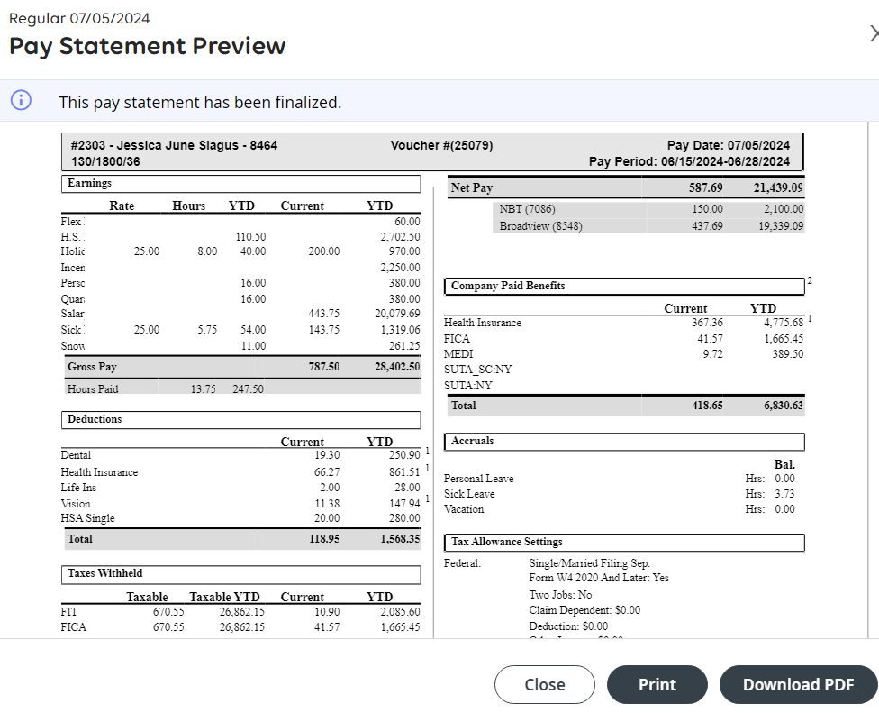
Current pay stub
Click on My Pay to see the last 3 pay information.
Where do you click to SEE a copy of your check and pay statement?

Slide 17
Viewing Past Pay Statements From the main menu the ”My Pay ” menu, Tap the Pay History menu option The Historical tab allows you to enter a date range

Slide 18
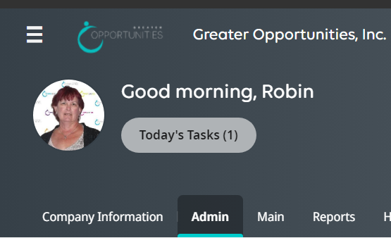
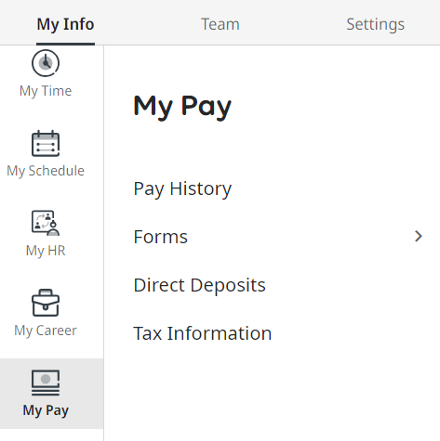
Viewing Past Pay Statements From the main menu Another way you can access your pay history is from the hamburger menu My Info-My Pay-pay history

Slide 19
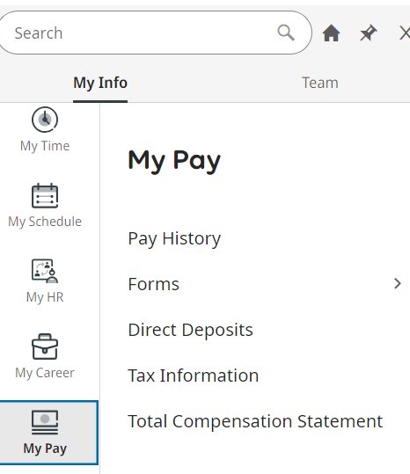
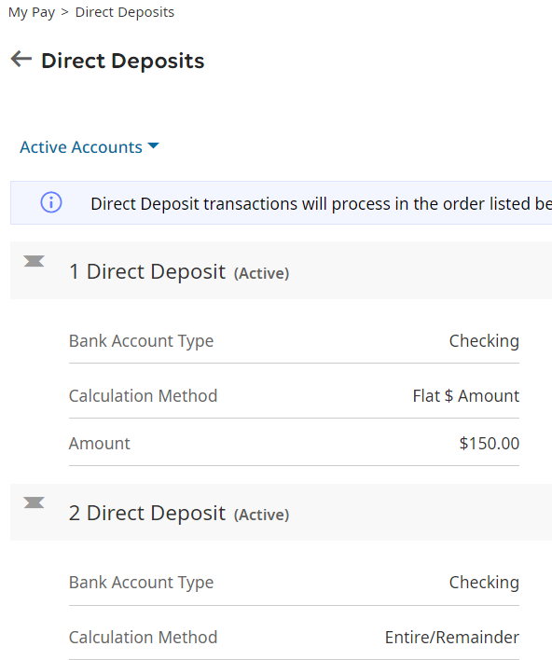
Viewing Current direct deposit From the main Hamburger menu My Pay menu, Tap the Direct deposit menu option This displays your current direct deposit

Slide 20
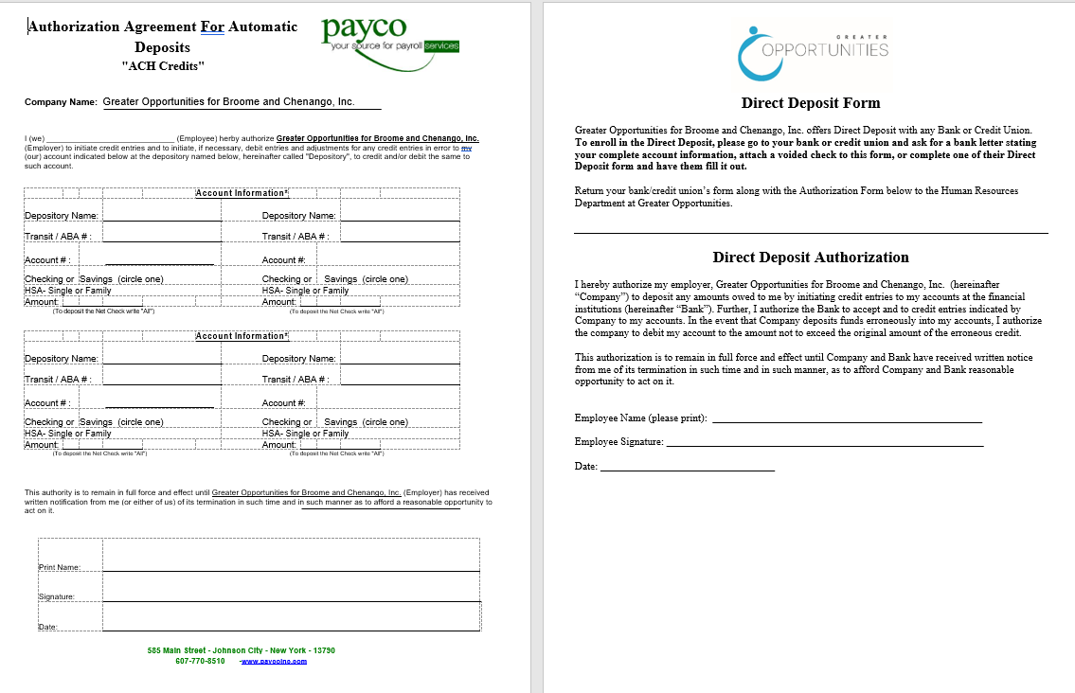
Changing direct deposit Contact human resources to change, update, or add a new direct deposit

Slide 21
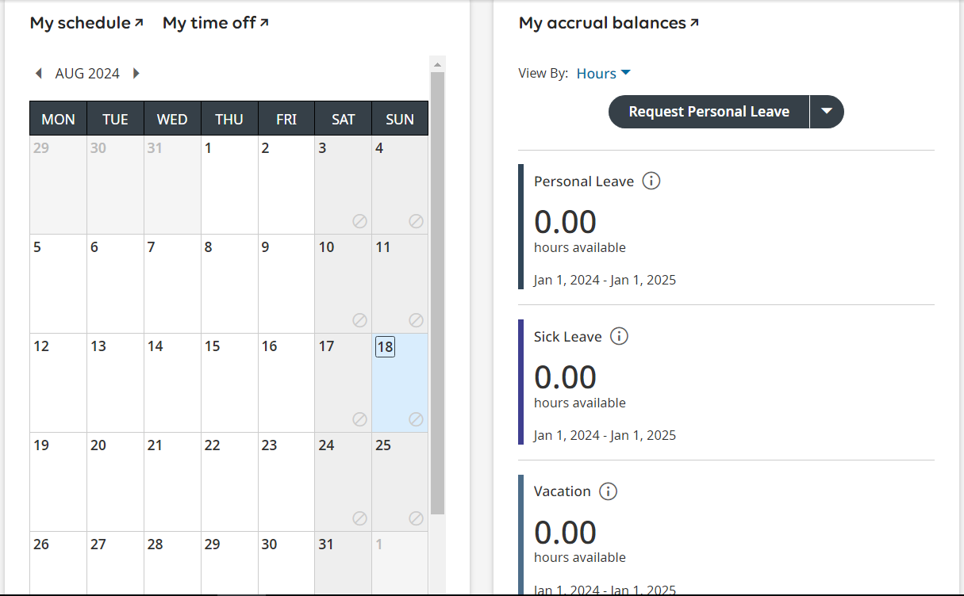
My Schedule and Time Off Calendar –
Main page
Easy access to approved or pending time off
“My Accrual Balances”

Slide 22
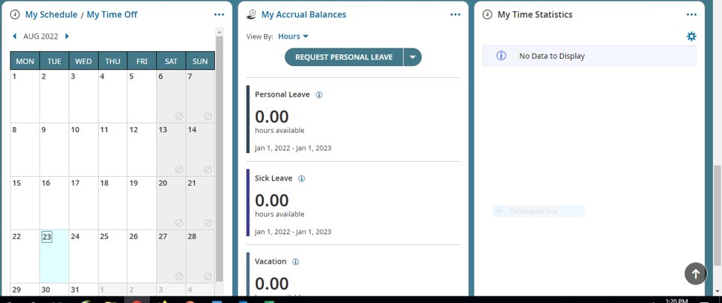
How do you start a time off request from this screen?

Slide 23
My Accrual Balances
to request time off click on the drop down

Slide 24
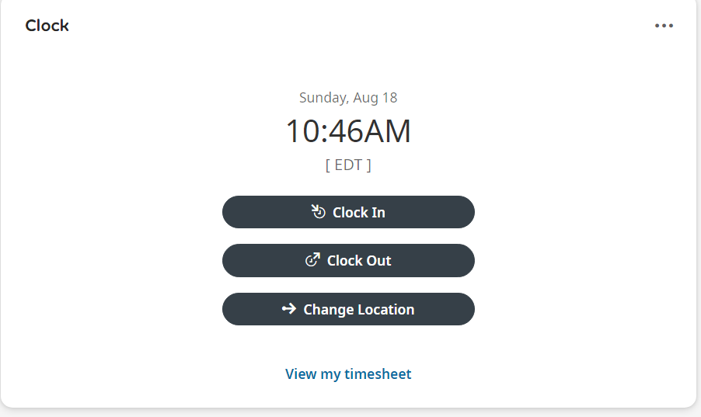
“My Timesheet” is below the Start widget this is where you can clock in/out and change locations You are also able to access your current timesheet by clicking ”My Timesheet”

Slide 25
Current Time Sheet What is the problem with this timesheet?

Slide 26
Missing punches! How do we fix the missing punches?

Slide 27
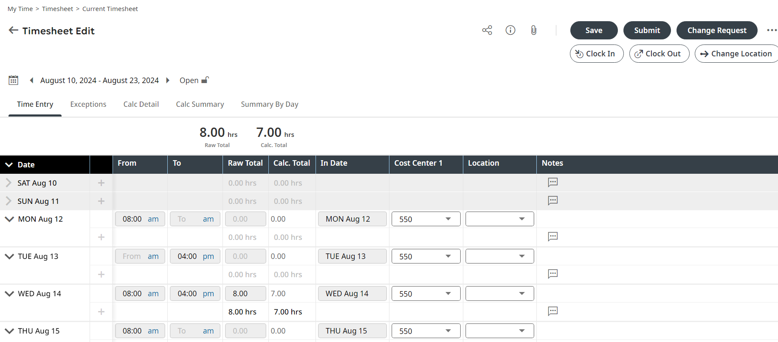
Timesheet Change Request!
In the upper right-hand corner of your time sheet choose Change Request

Slide 28
Timesheet Change Request!

Slide 29
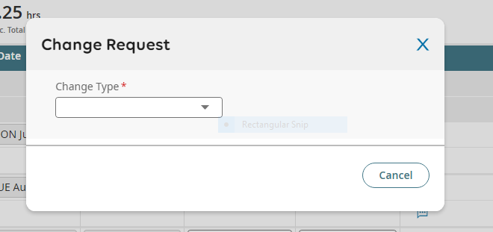
Change Type This option allows you to enter your missed in and/or out punch

Slide 30
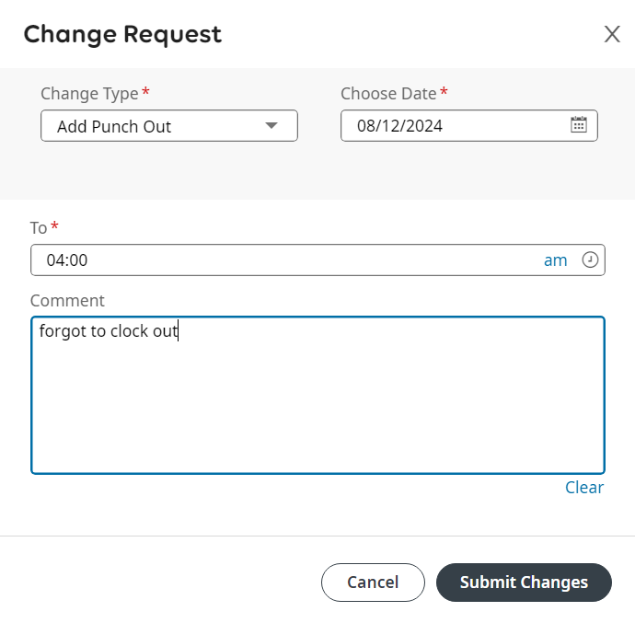
Change Request This option allows you to enter Your Missed Punch

Slide 31
Change Request in the comment section you can add a reason for the request!

Slide 32
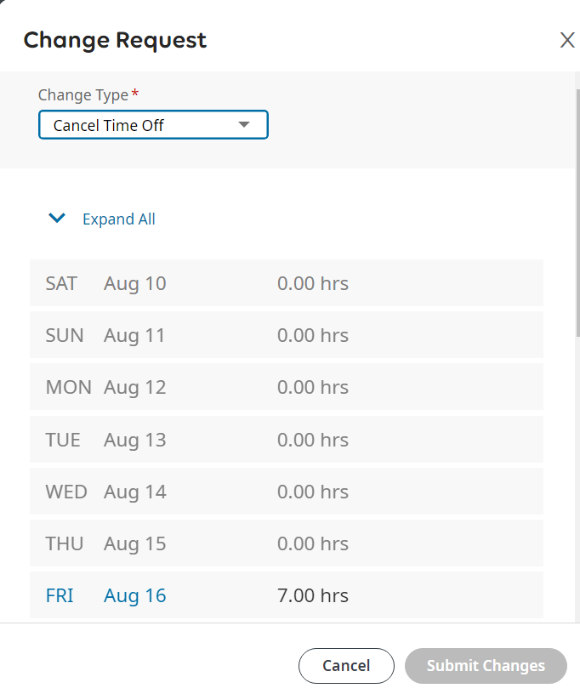
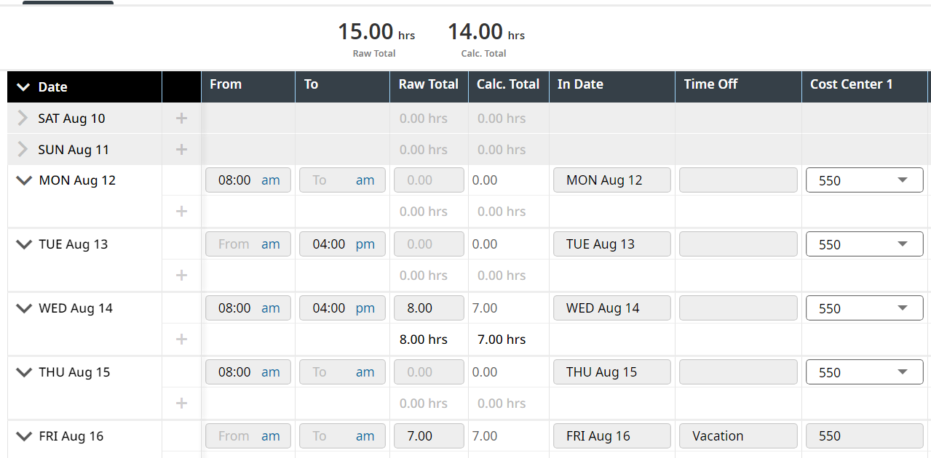
WHAT OTHER OPTIONS DO YOU HAVE IN THE CHANGE REQUEST?
CANCEL TIME OFF
MODIFY CLOCK IN
MODIFY CLOCK OUT
MODIFY TIME OFF

Slide 33
When is the correct time for an Employee to enter a time off request?
A request for vacation leave must be approved at the discretion of the Department Director and/or supervisor in advance. A request greater than two (2) consecutive days needs a minimum of one-week advance notice and approval.
Time off needs to be requested and approved as far in advance of the time of as possible.

Slide 34
Employee Badge Policy
Narrative Description of Policy:
It is the policy of Greater Opportunities for Broome and Chenango (GOBC) that all employees will be issued and must wear identification badges as provided by GOBC.
Identification badges must be worn in a manner that allows identification of an employee by photographic image, first and last names and position title to be conspicuous to others.
Employees forgetting or misplacing their identification badge will be given a temporary identification badge to wear that also clearly indicates their first and last name and their job title.

Slide 35
Employee Badge Policy
WHO DO YOU CONTACT TO GET AN ID BADGE OR REPLACE IT?

Slide 36
Employee Badge Policy
The HR Department will issue identification badges to all new employees and replacements.
Identification badges will include the following information:
1. Employee Picture
2. Employee First and Last Name
3. Position Title
4. Greater Opportunities Logo
Badges will be updated to reflect current information such as name or position changes
If an employee needs a new badge due to loss, the employee will be charged a $5.00 fee. There is no fee for issuing an identification badge when an employee’s name or job title changes.

Slide 37
Employee Badge Policy
Badges must be clipped to clothing on the front of the employee, at least six inches above the waist or worn on a lanyard.
Every effort should be made to ensure identification information is clearly visible to others. Badges may not be worn on belts, sleeves, pockets, footwear, etc.
Badges must not be deliberately worn in a manner that prevents a person’s name or job title from being visible.
Supervisors will make arrangements for employees who forget or misplace their identification badge, to wear a temporary badge that includes their first and last name and their job title. This may be worn for up to three days, by which time the employee either needs to wear the identification badge that was issued to them or obtain a replacement badge from the HR Department.
Identification Badges may be used for identification purposes when traveling on GOBC business.

Slide 38
Who do you contact if you get locked out of your computer?
THE IT DEPARTMENT RESETS
YOUR COMPUTER SIGN - ON!

Slide 39
WHAT IS THE DIFFERENCE BETWEEN AN HSA AND AN HRA?
Health Savings Accounts (HSAs) and Health Reimbursement Arrangements (HRAs) are both ways to pay for eligible medical expenses, but they differ in ownership, funding, and portability
HSAs are owned by the individual, while HRAs are owned by the employer.
HSAs are funded by pre-tax contributions from the individual, while HRAs are typically funded solely by the employer.

Slide 40
WHAT IS THE DIFFERENCE BETWEEN AN HSA AND AN HRA?
HSAs are portable, even if you change jobs, but HRAs may not be. If you leave your job, you lose access to your HRA account unless you elect COBRA coverage. Any remaining money in your HRA goes back to your employer.
With an HSA, the employee has more flexibility to control how much money they set aside for healthcare costs and how much money is spent. With an HRA, the employer sets the limit and determines which expenses will be reimbursable.
HSA funds can earn interest and be invested, just like money in a 401(k) or IRA, but HRA funds cannot. In many cases, the money in the HRA must be spent the year it is contributed or you lose it.

Slide 41
If i were a hacker where could i go to get all your personal information in one place??
SECURITY

Slide 42
social security # Date of birth banking information wages paystubs W2’s
SECURITY
PAYCO

Slide 43
SECURITY TWO-FACTOR Authentication

Slide 44
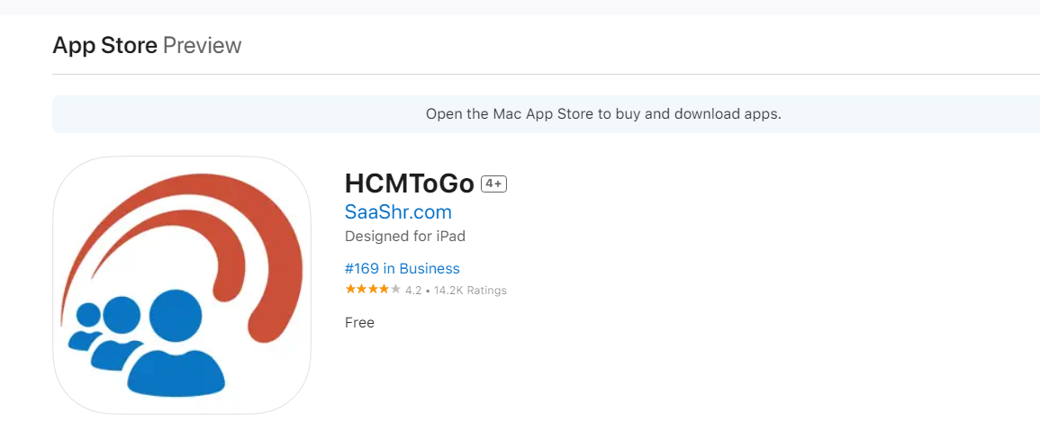
HCMTOGO APP
Everything we just presented can also be completed on the HCMTOGO App

Slide 45
Who submits the time card?
EMPLOYEE

Slide 46
Who approves the time card?
Supervisor

Slide 47
When do you submit your time card?
THE LAST FRIDAY OF THE PAYPERIOD OR THE LAST DAY YOU WORK IN THE PAYPERIOD!

Slide 48
What do you do if your timecard is incorrect when you are ready to submit it?
NOTIFY YOUR SUPERVISOR TO MAKE CORRECTONS before you submit!

Slide 49
When is payroll processed?
THE MONDAY BEFORE PAYDAY!

Slide 50
QUESTIONS??

