Slide 1
Greater Ops. Policy and Procedure for Assurance of Educational Rights Under the McKinney-Vento Homeless Assistance Act

Slide 2
What is the McKinney-Vento Act???
Federal legislation that ensures the educational rights and protections of children and youth experiencing homelessness.
The McKinney-Vento Act states that children and youth who lack “a fixed, regular, and adequate nighttime residence” will be considered homeless.

Slide 3
Those who lack a fixed, regular, and adequate nighttime residence include:
Children and youths who are sharing the housing of other persons due to loss of housing, economic hardship, or a similar reason. “Doubled up”
Living in motels, hotels, trailer parks, or camping grounds due to the lack of alternative accommodations; are living in emergency or transitional shelters; or are abandoned in hospitals;
Places that are public or private not designed for, or ordinarily used as, a regular sleeping accommodation for human beings. This includes parks, vehicles, substandard housing, abandoned buildings, bus station, or similar settings.
Migratory children who qualify as homeless because they are living in circumstances described above.

Slide 4
McKinney Vento eligible students have the right to:
receive a free, appropriate public education;
enroll in school immediately, even if lacking documents normally required for enrollment, or having missed application or enrollment deadlines during any period of homelessness;
enroll in school and attend classes while the school gathers needed documents;
continue attending the school of origin, or enroll in the local attendance area school if attending the school of origin is not in the best interest of the student or is contrary to the request of the parent, guardian, or unaccompanied youth;

Slide 5
receive transportation to and from the school of origin, if requested by the parent or guardian, or by the local liaison on behalf of an unaccompanied youth; and
receive educational services comparable to those provided to other students, according to each student’s need.

Slide 6
Policy Purpose
To put forth agency expectations for program staff on communicating and advocating for the rights of homeless parents and students.

Slide 7
Who does this apply to???
ALL STAFF that have contact with homeless parent, child, and/or student.

Slide 8
Staff Responsibilities
If/when staff make contact with a homeless parent and/or student staff will:
Inform parent and/or student of their rights in writing (pamphlets at facilities)
Inform the parent and/or student of the local school district Homeless Liaison https://www.nysteachs.org/homeless-liaison-contact-list
DOCUMENT in COPA
If there are any questions, direct them to our agency Homeless Liaisons
Broome Head Start: ERSEA Coordinator, Katie Grove
Chenango Head Start: EHS Family Services Coordinator, Tiffany D’Angelo
Housing: Director of Housing Services, Justin Roberts and designees

Slide 9
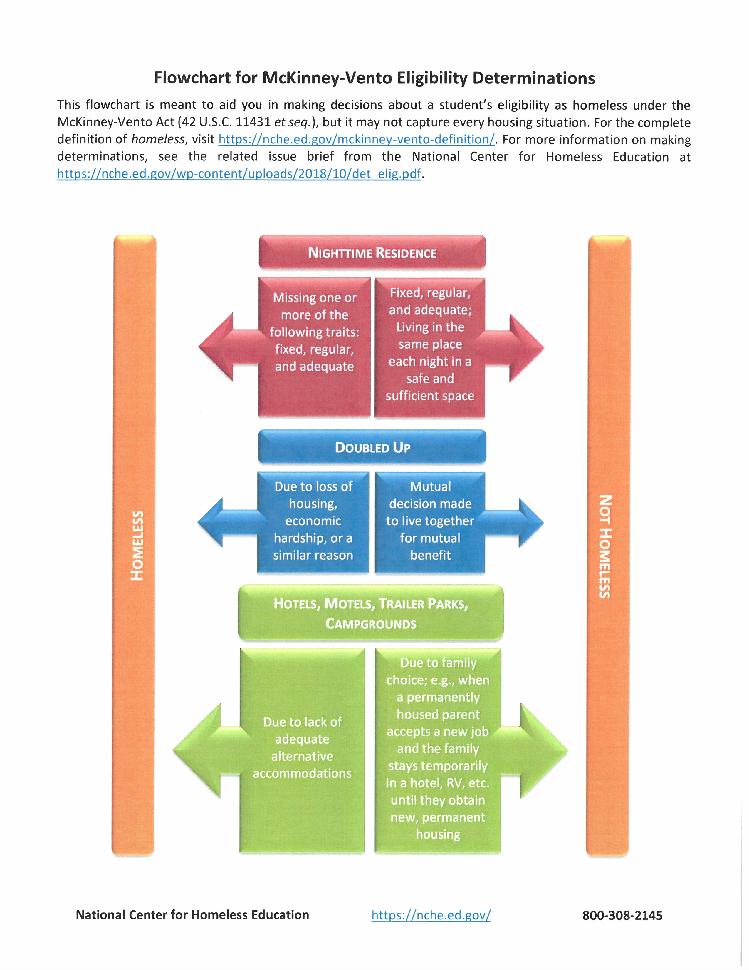

Slide 10
