Slide 1
Vehicle Accident Procedure
Bulk Ordering
Maintenance Updates

Slide 2
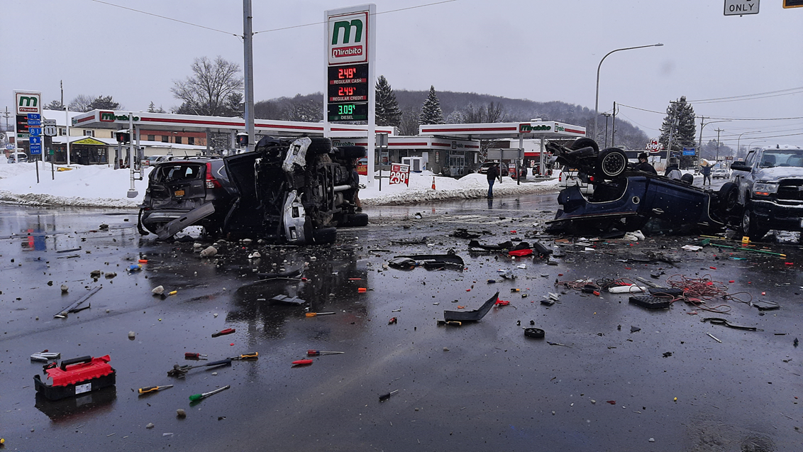
Vehicle Accident Procedure
What to do if you get into an accident with an agency vehicle?

Slide 3
Vehicle Accident Procedure
Take immediate action to prevent further damage at the scene of the accident:
-Pull onto side of road to get you and your vehicle out of traffic if possible.
-Put on hazard lights.
Call 911. Request assistance as needed.
Notify your Supervisor.

Slide 4
Vehicle Accident Procedure
Supervisor will contact Maintenance, arrange transportation if needed, notify Fiscal Director, and notify HR Director (staff/client injury)
Be courteous. Answer police questions. Give identifying information to the other party(ies) involved, but make no comments about assuming responsibility.

Slide 5
Vehicle Accident Procedure
Remove Vehicle Accident Report Form from glove compartment and fill out completely.
Secure names and addresses of all witnesses to the accident.
Vehicle Accident Report must be scanned/emailed to Fiscal Director asap upon return to program/department. (Send original to the Fiscal Dept. – interoffice mail).

Slide 6
Vehicle Accident Procedure
If vehicle needs to be towed during regular business hours, contact the Maintenance Department:
Broome County: (607) 760-4135, (607) 427-1016
Chenango County: (607) 316-0551, (607) 427-1016
If vehicle needs to be towed outside of regular business hours, contact the afterhours maintenance on-call phone:
Broome County: (607) 221-5108
Chenango County: (607) 316-0551
*If no answer, call Facilities Director at (607) 427-1016

Slide 8
Vehicle Accident Procedure

Slide 9
Bulk Ordering for Maintenance & Kitchen Supplies
Greater Opportunities is now doing bulk ordering for maintenance and kitchen supplies (Stored at each Maintenance Department)
Reduced costs
Minimizes amount of supply storage needed at sites
Supplies readily available
Eliminates multiple brands of the same product

Slide 10
Bulk Ordering for Maintenance & Kitchen Supplies
Examples of products ordered on the Maintenance & Kitchen Supply Order Form include:
Paper plates, cups, napkins, paper towels, toilet paper, disposable gloves, dishwasher detergent, delimer, rinse aid, garbage bags, cleaning products, etc.

Slide 11
Maintenance & Kitchen Supply Ordering Procedure
All requests for maintenance and kitchen supplies must be filled out on the “Maintenance & Kitchen Supply Request Form” (fillable form on G-Drive).
The person requesting the order should fill in the name of location, date, quantity requested, and “requested by” section. Please note specific amounts (e.g. 6 rolls, 1 case, etc.) to ensure the order is filled correct.

Slide 13
Maintenance & Kitchen Supply Ordering Procedure
If there is a product that is not on the form, please manually add to one of the blank lines in the “Miscellaneous Products” section on 2nd page.

Slide 14
Maintenance & Kitchen Supply Ordering Procedure
Orders for maintenance and kitchen supplies are to be emailed bi-weekly to the Maintenance Department no later than the Fridays that timesheets are submitted.

Slide 15
Maintenance & Kitchen Supply Ordering Procedure
Staff in Broome County will email the form to:
Distro- Broome Maintenance
BroomeMaintenance@greaterops.org
Staff in Chenango County will email the form to:
Distro- Chenango Maintenance
ChenangoMaintenance@greaterops.org

Slide 16
Maintenance & Kitchen Supply Ordering Procedure
The order will be ready for pick-up on the following Friday (Pay Day).
Broome County – Main Office Mail Room
Chenango County – Maintenance Shop

Slide 17
Maintenance & Kitchen Supply Ordering Procedure
The Maintenance Department will communicate to program if any product is on backorder.
The Maintenance Department will be responsible for replenishing stocked supplies.

Slide 18
Maintenance and Kitchen Supply Ordering Procedure
Requests for maintenance and kitchen supplies should be placed prior to running out to avoid any emergency requests.

Slide 19
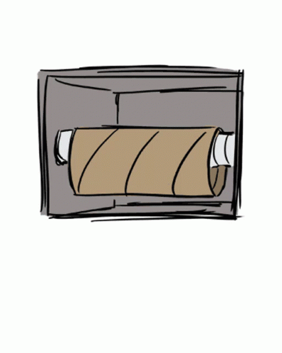
Maintenance and Kitchen Supply Ordering Procedure

Slide 20
Maintenance Forms Location
All Maintenance Forms are located on the G-Drive in the “Maintenance Procedures and Forms” folder.

Slide 21
Vehicle Accident Procedure

