Slide 1


Greater Opportunities for
Broome and Chenango Inc.
Narcan Training for Housing Staff: Saving Lives Amidst the Opioid Crisis
Recognizing and Responding to Opioid Overdose in Housing Facilities
Notes:
---
The opioid crisis is a growing public health emergency that has claimed countless lives. In this presentation, we will explore the impact of the opioid epidemic on housing facilities and communities, and the importance of intervention and training. We will introduce Narcan, a life-saving medication that can reverse opioid overdose, and discuss how to recognize an overdose, administer Narcan, and ensure legal and safety considerations. We will also offer ongoing support and resources for staff.

Slide 2
Understanding the Opioid Crisis
Notes:
The opioid epidemic is a public health emergency that has impacted communities across the country, including housing facilities. It is important for housing staff to understand the scope of the crisis and the need for intervention and training.

Slide 3

Overview of the Opioid Epidemic
Misuse and Addiction
  The opioid epidemic is a result of the widespread misuse and addiction to prescription painkillers and illegal opioids, which have caused a surge in addiction rates and overdose deaths.
Impact on Communities
  The opioid epidemic has devastated families and communities, leading to an increase in crime, homelessness, and other social problems.
Notes:
The opioid epidemic refers to the widespread misuse and addiction to prescription painkillers and illegal opioids. It has resulted in a dramatic increase in overdose deaths and has devastated families and communities.

Slide 4
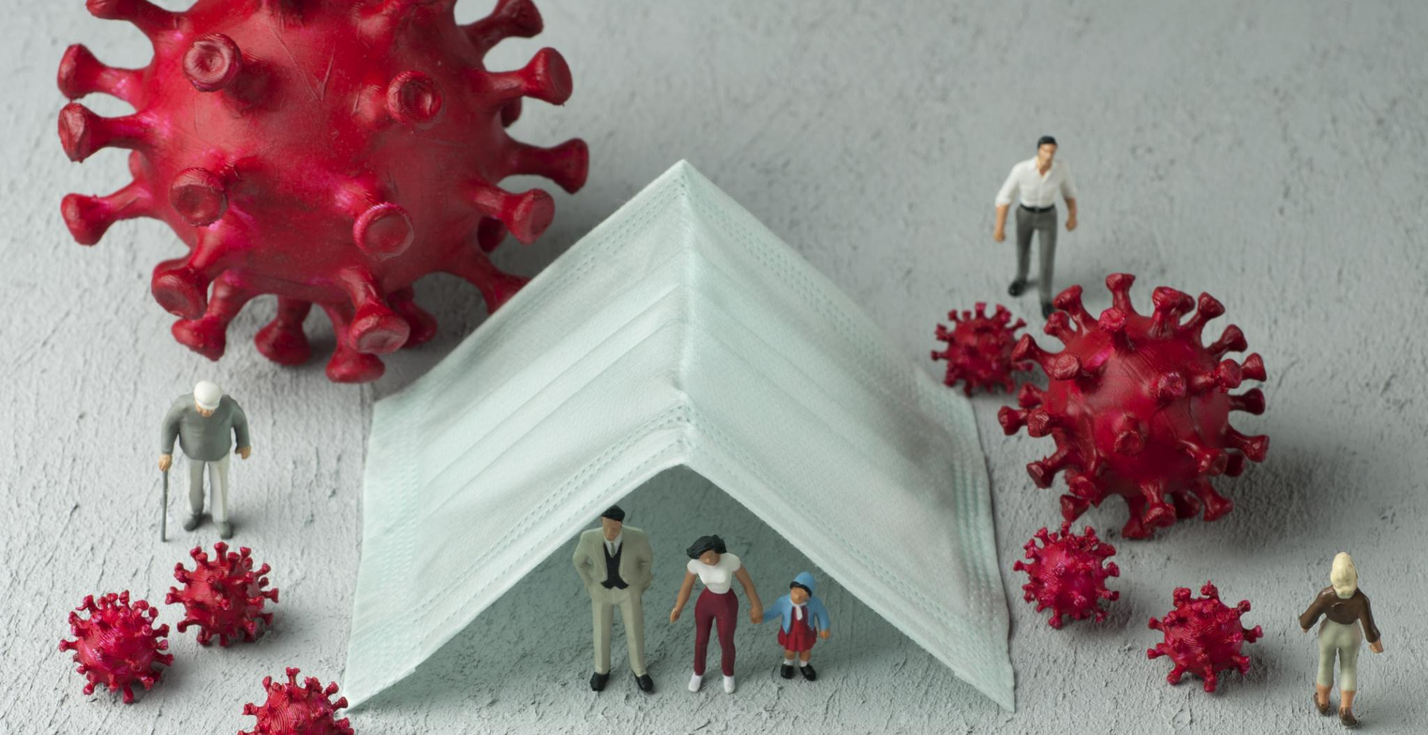
Impact on Communities and Housing Facilities
  The opioid epidemic has significantly impacted housing facilities, leading to an increase in overdose deaths and related health problems. Housing and Maintenance staff need to be prepared to respond to an overdose and provide support to residents to prevent further harm. They also need to be prepared to take safety precautions when finding drug paraphernalia.
Notes:
The opioid epidemic has had a significant impact on housing facilities, with an increase in overdose deaths and related health problems. Housing staff need to be prepared to respond to an overdose and provide support to residents.

Slide 5
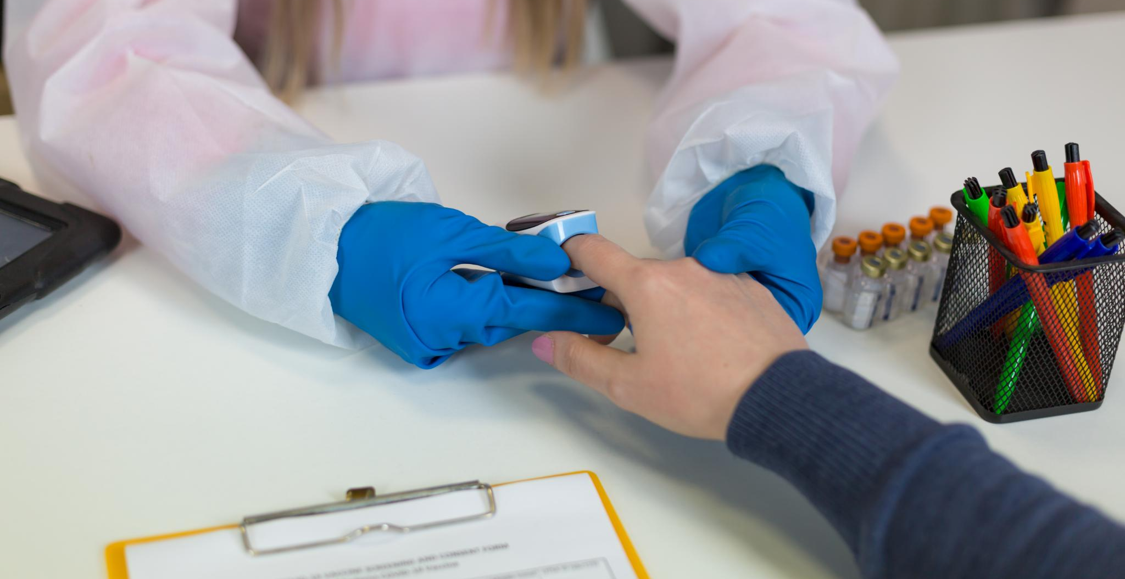
Importance of Intervention and Training
  Intervention and training are critical in addressing the opioid epidemic and saving lives. Housing and Maintenance staff can play a vital role in identifying and responding to overdoses, and Narcan training is essential in ensuring that staff are prepared to act if necessary.
Notes:
Intervention and training are critical in addressing the opioid epidemic and saving lives. Housing staff can play a vital role in identifying and responding to overdoses, and Narcan training is essential in ensuring that staff are prepared to act.

Slide 6
Introduction to Narcan
Notes:
Narcan is a medication that can reverse opioid overdose and save lives. It is a vital tool in the fight against the opioid epidemic, and housing staff should be knowledgeable about its use and administration.

Slide 7
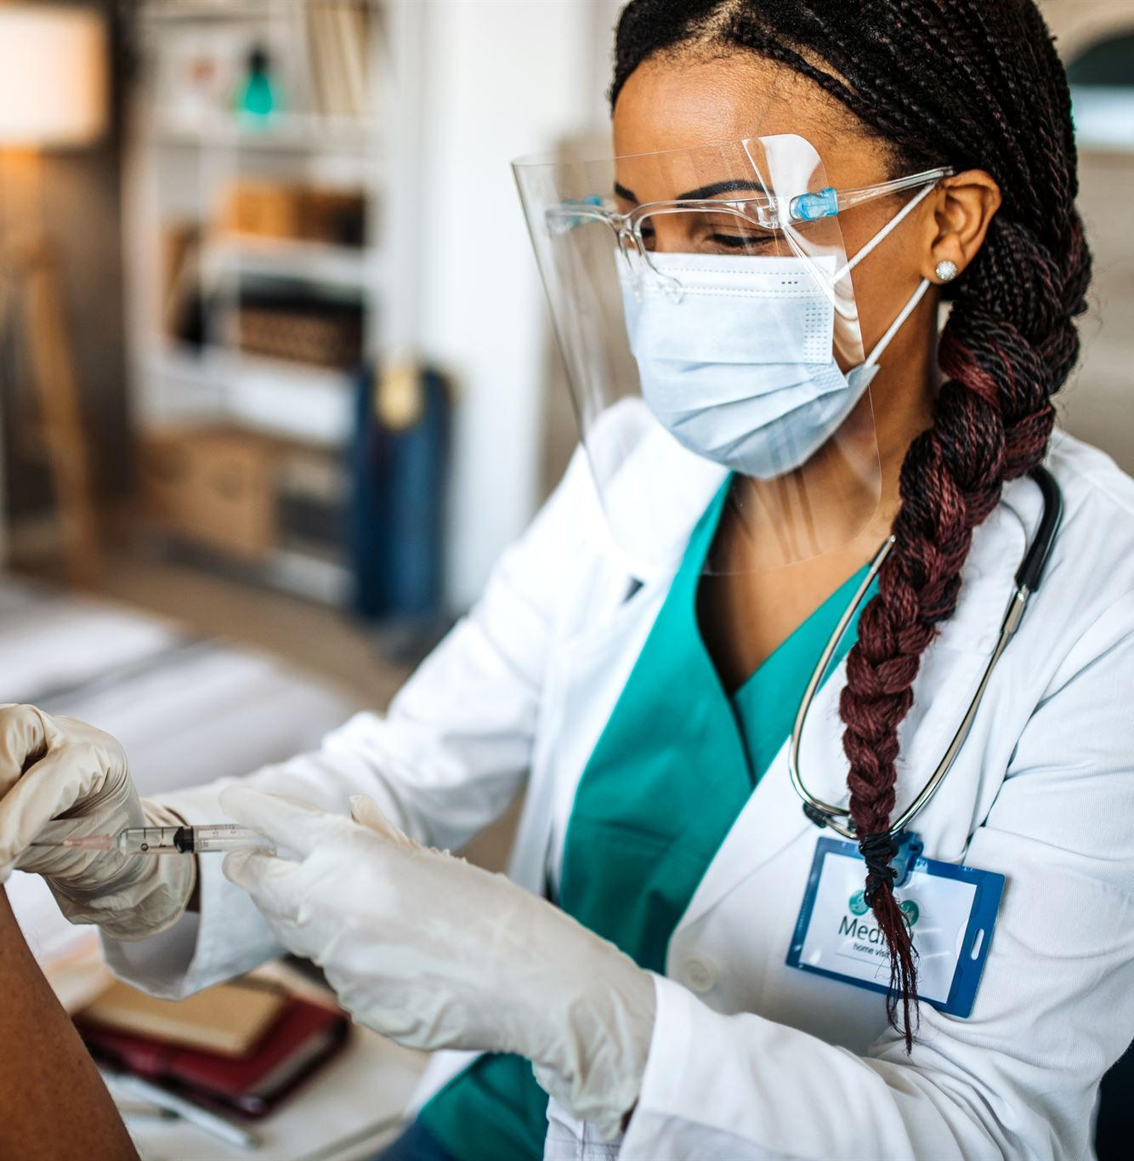
What Is Narcan?
  Narcan, a brand name for Naloxone, is a medication that can quickly reverse the effects of an opioid overdose. It works by binding to the same receptors in the brain as opioids, reversing the effects of the overdose. Narcan is a vital tool in saving the life of someone experiencing an opioid overdose and should be readily available to all medical personnel.
Notes:
Narcan is a brand name for Naloxone, a medication that can quickly reverse the effects of an opioid overdose. It works by binding to the same receptors in the brain as opioids, reversing the effects of the overdose.

Slide 8

How Narcan Works
  Narcan works by blocking the effects of opioids in the brain, which restores normal breathing and can quickly reverse an overdose.
Notes:
Narcan works by blocking the effects of opioids in the brain and restoring normal breathing. It can quickly reverse an overdose and save a life.

Slide 9
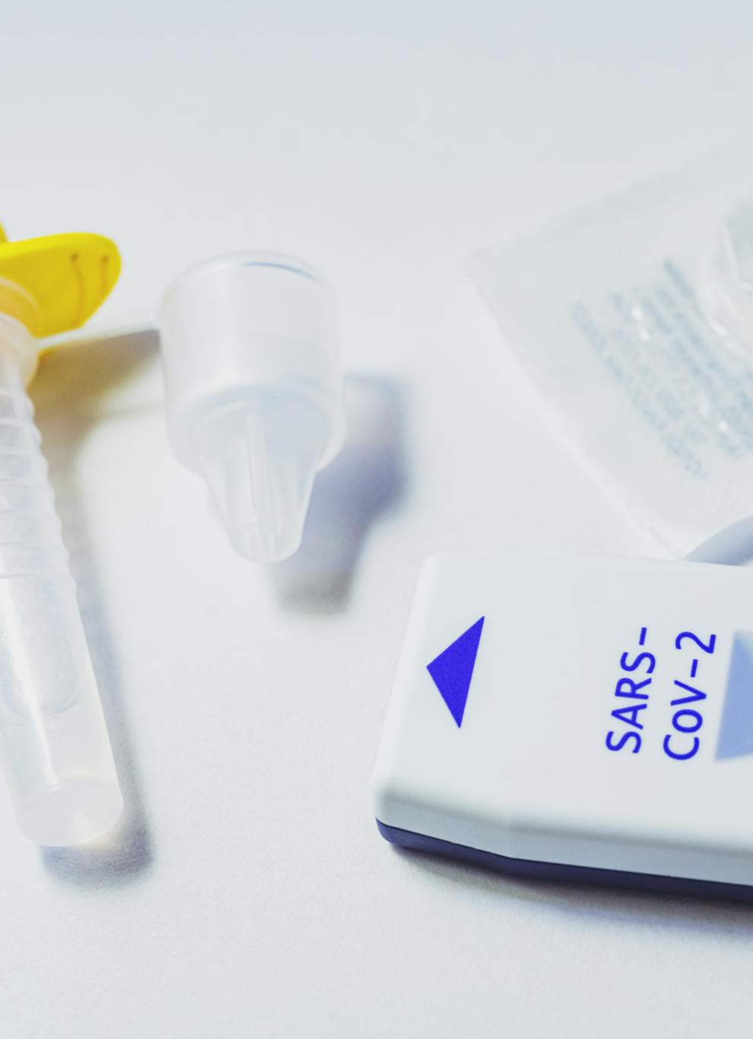
Forms of Narcan Available
Nasal Spray
  Narcan nasal spray is a form of naloxone that is used to treat opioid overdose. It is easy to use and can be administered by anyone with minimal training.
Injectable
  Narcan injectable is a form of naloxone that is used to treat opioid overdose. It is administered through an injection and requires more training than the nasal spray form.
Auto-Injectable Devices
  Narcan auto-injectable devices are a new form of naloxone that is used to treat opioid overdose. They are easy to use and can be administered quickly in an emergency.
Notes:
Narcan is available in several forms, including nasal spray, injectable, and auto-injectable devices. Housing staff should be aware of the different forms of Narcan and how to use them.

Slide 10
Recognizing Opioid Overdose
Notes:
Recognizing the signs and symptoms of an opioid overdose is critical in responding quickly and providing life-saving care. Housing staff should be knowledgeable about the risk factors and warning signs of overdose.

Slide 11

Signs and Symptoms of an Overdose
  The signs and symptoms of an overdose can include slowed or stopped breathing, blue lips or fingertips, and unresponsiveness.
Notes:
The signs and symptoms of an overdose can include slowed or stopped breathing, blue lips or fingertips, and unresponsiveness. Recognizing these symptoms can help housing staff respond quickly and provide life-saving care.

Slide 12

Risk Factors for Overdose
History of Opioid Use
  Individuals with a history of opioid use are at greater risk for overdose, especially if they have a high tolerance to opioids.
Using Alone
  Using opioids alone increases the risk of overdose as there is no one to administer naloxone in case of an emergency.
High Dose of Opioids
  Using a high dose of opioids increases the risk of overdose, especially if the individual has a low tolerance to opioids.
Notes:
Risk factors for overdose include a history of opioid use, using alone, and using a high dose of opioids. Housing staff should be aware of the risk factors and take steps to prevent overdoses from occurring.

Slide 13
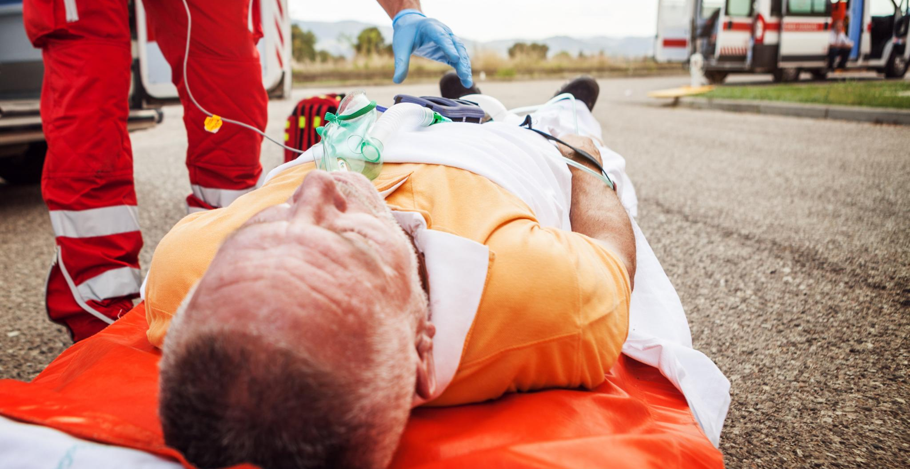
When and How to Act
  Quickly responding to an overdose is critical in saving a life. Housing and Maintenance staff should call 911 immediately and provide care until emergency responders arrive. If available, Narcan should be administered to the person experiencing the overdose.
Notes:
Responding quickly to an overdose is critical in saving a life. Housing staff should call 911 immediately, administer Narcan if available, and provide care until emergency responders arrive.

Slide 14
Administering Narcan
Notes:
Administering Narcan is a simple process, but it is important to follow the correct steps to ensure that the medication works effectively.

Slide 15
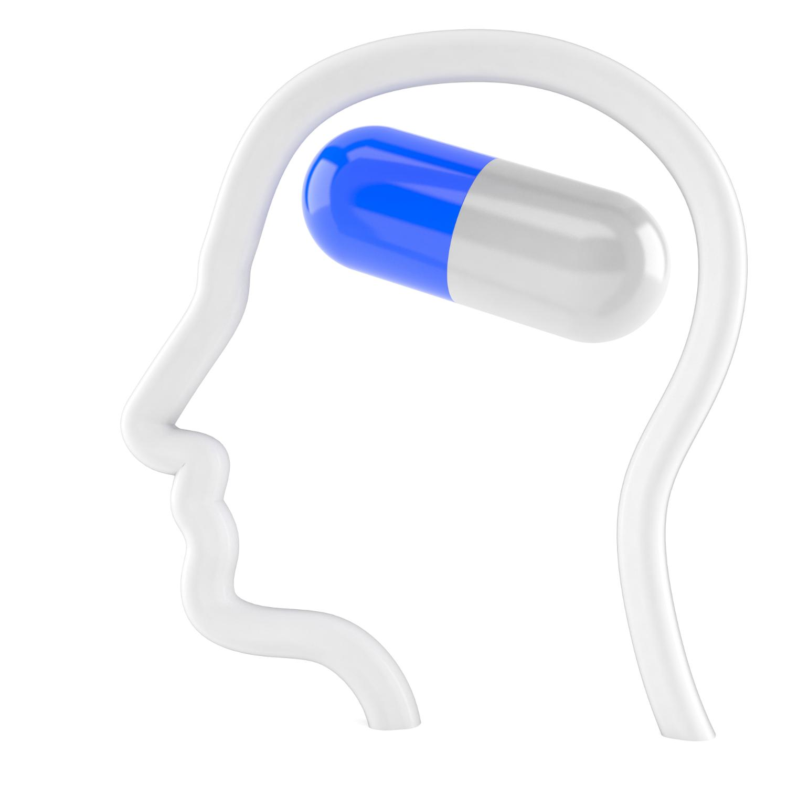
Step-by-Step Administration Guide
Narcan Administration
  Narcan is a nasal spray used to treat opioid overdose. To administer it, remove the device from its packaging and insert the nozzle into the nostril and press the plunger.
No Response in 2-3 Minutes
  If no response is seen within 2-3 minutes after administering the first dose of Narcan, administer a second dose.
Notes:
To administer Narcan, remove the device from its packaging, insert the nozzle into the nostril, and press the plunger. If no response is seen within 2-3 minutes, administer a second dose.

Slide 16
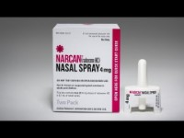

Slide 17

Dosage and Frequency
Standard Dosage of Narcan
  The standard dose of Narcan is 4mg, but the appropriate dose may vary depending on the individual's weight, tolerance, and other factors that may affect the metabolism of the drug.
Individualized Dosage of Narcan
  The appropriate dose of Narcan may vary depending on the individual's weight, tolerance, and other factors that may affect the metabolism of the drug. Housing staff should be trained to administer the correct dose of Narcan based on an individual's specific needs.
Notes:
The standard dose of Narcan is 4mg, but the appropriate dose may vary depending on the individual. Housing staff should be trained to administer the correct dose and frequency of Narcan.

Slide 18
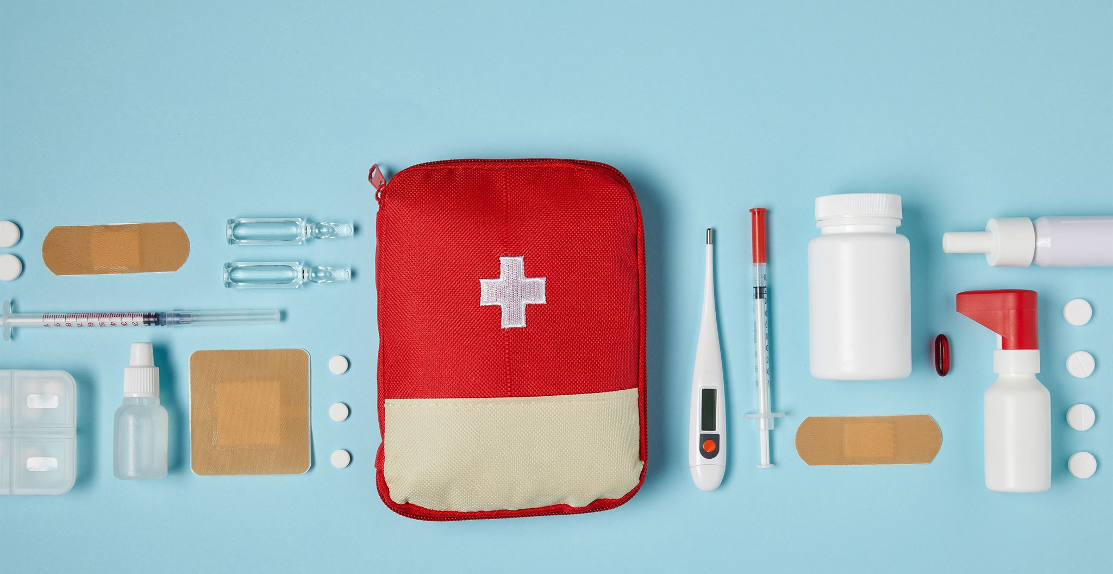
Post-Administration Care
  After administering Narcan, it is important to monitor the individual's breathing and heart rate and keep them calm and comfortable until emergency responders arrive.
Notes:
After administering Narcan, it is important to provide care to the individual until emergency responders arrive. This can include monitoring their breathing and heart rate and keeping them calm and comfortable.

Slide 19
Legal and Safety Considerations
Notes:
Legal and safety considerations are important when administering Narcan. Housing staff should be aware of the legal protections for Narcan use, follow safety precautions during and after administration, and report and document incidents.

Slide 20
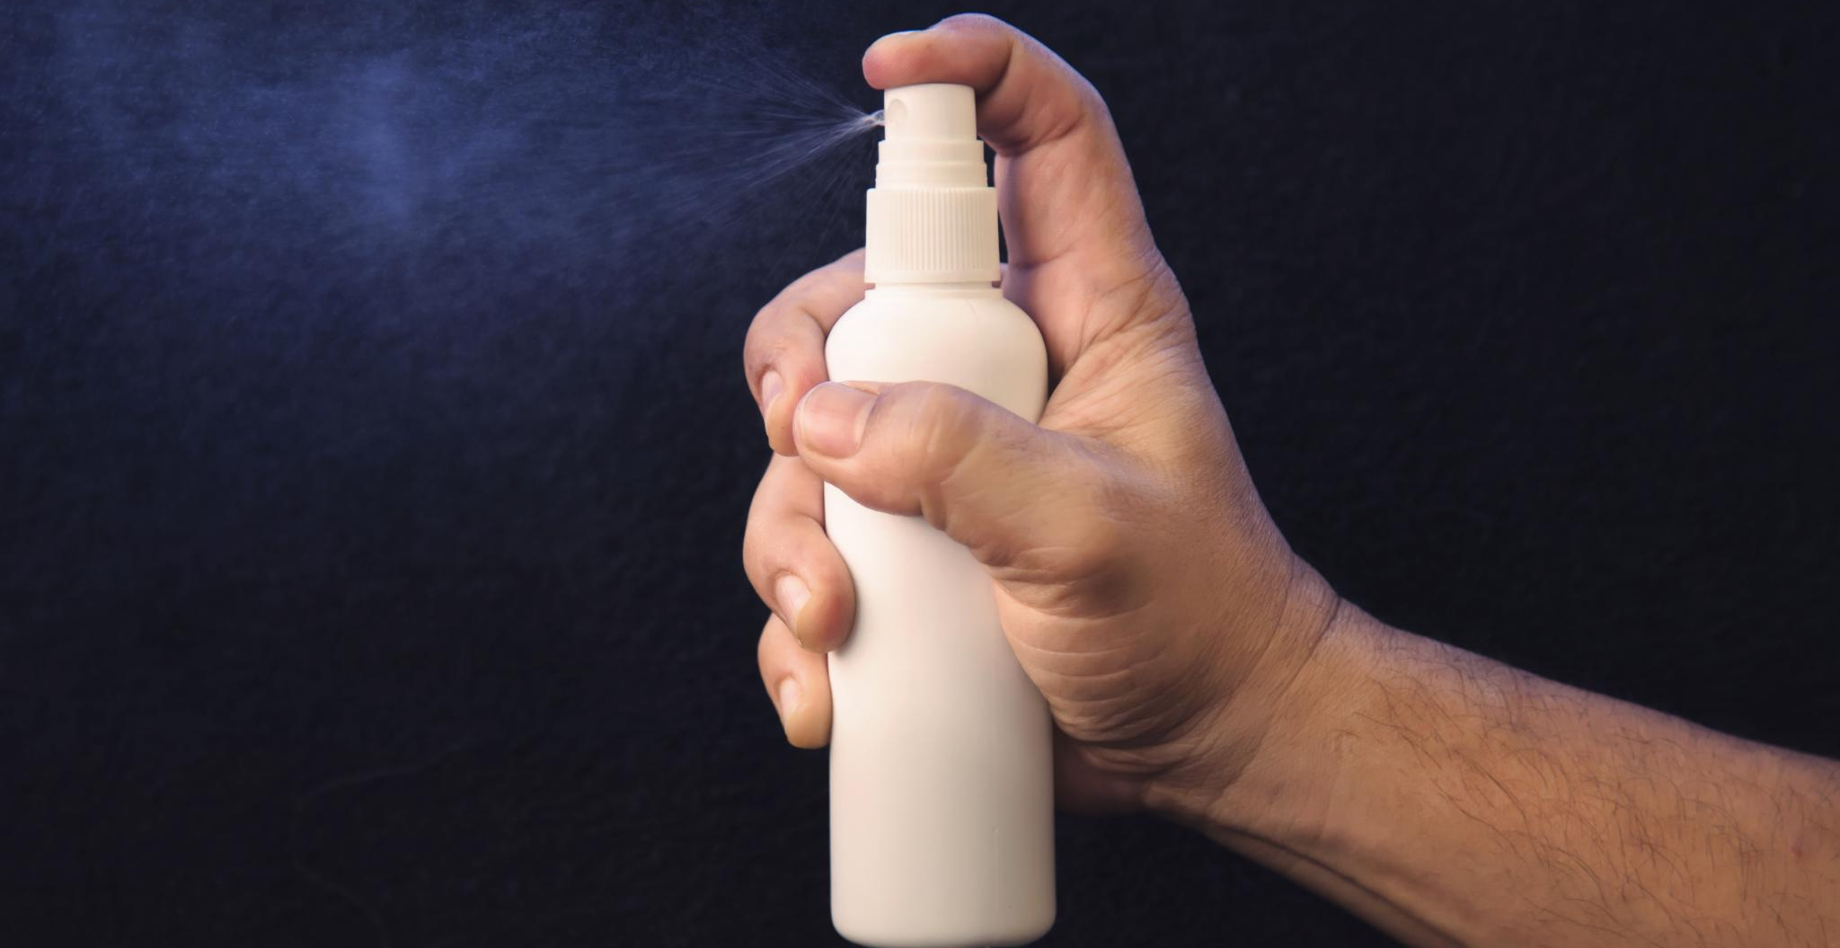
Legal Protections for Narcan Use
  Good Samaritan laws provide legal protection to individuals who administer Narcan in an emergency situation by granting immunity from prosecution for drug-related offenses.
Notes:
Narcan use is protected by Good Samaritan laws in many states, which provide immunity from prosecution for drug-related offenses when calling for help or administering Narcan in an emergency.

Slide 21

Safety Precautions During and After Administration
Safety Precautions during Administration
  When administering Narcan, housing and maintenance staff should follow safety precautions such as wearing gloves and safely disposing of the device.
Monitoring After Administration
  After administration of Narcan, it is important to monitor the individual and provide post-overdose care.
Notes:
Housing staff should follow safety precautions when administering Narcan, including wearing gloves and disposing of the device safely. After administration, it is important to monitor the individual and provide post-overdose care.

Slide 22

Reporting and Documenting Incidents
Reporting and Documenting Incidents
  Reporting and documenting incidents involving Narcan administration is essential for quality improvement and tracking purposes. Staff should be trained in the proper procedures for reporting these incidents.
Notes:
Incidents involving Narcan administration should be reported and documented for quality improvement and tracking purposes. Housing staff should be familiar with the reporting and documentation procedures.

Slide 23
Avoiding Exposure and Staying Safe
Notes:
The opioid epidemic is a public health emergency that has impacted communities across the country, including housing facilities. It is important for housing staff to understand the scope of the crisis and the need for intervention and training.

Slide 24
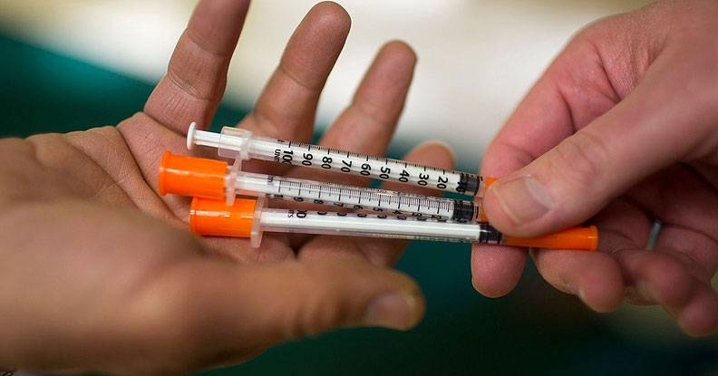
Guidelines when finding Needles:
When housing or maintenance staff find a used needle or drug paraphernalia in an apartment or on Greater Opportunities properties, it is crucial to follow safety precautions to avoid exposure to harmful substances.
Do NOT pick up Needles Bare Handed. Picking up needles with bare hands can lead to dangerous exposure. Even the smallest bit of exposure can cause serious harm.
Wear Gloves: Always wear gloves when handling needles or drug paraphernalia to protect against potential exposure to harmful substances1.
Use Proper Disposal Methods: Dispose of needles and paraphernalia in a puncture-proof container, such as a detergent bottle, that can be capped and sealed for transport to a proper disposal site.
Report and Document Incidents: (If your organization requires this) Reporting and documenting incidents involving drug paraphernalia is essential for quality improvement and tracking purposes. Staff should be trained in the proper procedures for reporting and documenting these incidents. Currently, Greater Opportunities does NOT require documentation.
Notes:
We will start by discussing the opioid epidemic and its impact on housing facilities and communities. Then, we will introduce Narcan, a medication that can reverse opioid overdose. We will explore how to recognize an overdose, administer Narcan, and ensure legal and safety considerations. Finally, we will offer ongoing support and resources for staff.

Slide 25
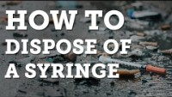

Slide 26

Exposure to used needles or drug paraphernalia can:
Put individuals at risk of infections such as Hepatitis B or C, HIV, and bacterial infections like staph. These infections can occur if another person's blood or body fluid touches your skin, eyes, mouth, or other mucosal surfaces.
Additionally, discarded needles can pose a major health threat as they can contract blood-borne diseases or be exposed to remnants of drugs.
By ensuring proper disposal, we can:
Protect public health
Reduce environmental pollution
Promote a safer and healthier living environment for our tenants and staff.
.

Slide 27
Ongoing Support and Resources
Notes:
Ongoing support and resources are necessary in addressing the opioid epidemic and ensuring that housing staff are prepared to respond to overdoses. These can include access to Narcan and supplies, training and refreshers for staff, and community resources and support networks.

Slide 28

Accessing Narcan and Supplies
Pharmacies
  Narcan and related supplies can be obtained from many pharmacies, including national chains and local independent pharmacies.
Healthcare Providers
  Narcan and related supplies can be obtained from healthcare providers, including doctors, clinics, and hospitals, who can prescribe and administer these medications.
Community Organizations
  Many community organizations, including harm reduction programs and public health departments, offer Narcan and related supplies at no cost or at a reduced cost to those who need them.
Notes:
Narcan and related supplies can be obtained through various sources, including pharmacies, healthcare providers, and community organizations. Housing staff should be aware of the resources available to them.

Slide 29

Training and Refreshers for Staff
Importance of Training and Refreshers
  Training and refreshers for staff are crucial in ensuring they have the knowledge and skills to respond appropriately to overdoses. Ongoing training and refresher courses are necessary to keep staff up to date with the latest protocols and techniques.
Benefits of Training and Refreshers
  Training and refreshers for staff provide numerous benefits, including improved staff confidence, increased knowledge, and reduced risk of errors. Additionally, ongoing training and refresher courses help staff stay up to date with the latest trends and best practices.
Notes:
Training and refreshers for staff are essential in ensuring that they are knowledgeable and prepared to respond to overdoses. Housing facilities should provide ongoing training and refresher courses for staff.

Slide 30

Community Resources and Support Networks
  Community resources and support networks can provide additional support and resources for housing and maintenance staff as well as the residents. These can include counseling services, peer support groups, and harm reduction programs.
Notes:
Community resources and support networks can provide additional support and resources for housing staff and residents. These can include counseling services, peer support groups, and harm reduction programs.

Slide 31
Conclusion
Narcan Training
Narcan training is critical in addressing the opioid epidemic and saving lives. Housing staff should be trained in Narcan administration and overdose response to be prepared for emergency situations.
Housing Staff's Role
Housing staff have a vital role to play in identifying and responding to overdoses, and their knowledge and preparedness can make all the difference. By being trained in Narcan administration and overdose response, they can help to save lives.
Ensuring Legal and Safety Considerations
Housing staff should be aware of legal and safety considerations when responding to overdoses and administering Narcan.
Ongoing Support and Resources
Providing ongoing support and resources to those affected by opioid addiction is important in addressing the crisis. Housing staff can play a role in providing access to resources and support for those in need.
Notes:
Narcan training is critical in addressing the opioid epidemic and saving lives. Housing staff have a vital role to play in identifying and responding to overdoses, and their knowledge and preparedness can make all the difference. By understanding the opioid crisis, introducing Narcan, recognizing overdose, administering Narcan, ensuring legal and safety considerations, and providing ongoing support and resources, housing staff can help to save lives.

Slide 32
https://www.greaterops.org/forms/completion-of-training
Congratulations, you have completed this training. Please click on the link below to certify that you participated and understand the materials reviewed. The Learning and Development Director and your supervisor will be notified you have successfully completed this training.

