Slide 1
Vehicle Pre-Trip and Post-Trip Inspections
GPS Tracking
Vehicle Accident Procedure

Slide 2
Vehicle Pre-Trip Inspection

Slide 3
Vehicle Pre-Trip Inspection
PRIOR to driving an agency vehicle
Sign vehicle out
Fuel card, insurance card, registration
Exterior Check
Interior Check
Safe to Drive?

Slide 4
Vehicle Pre-Trip Inspection
An Accurate Vehicle Pre-Trip Inspection:
Keeps driver from leaving a facility with a vehicle that has an existing problem
Helps to ensure safety of the staff, clients, and others on the road

Slide 5
Vehicle Post-Trip Inspection
Close Windows
Remove Belongings
Lock Doors
Exterior Check
Return keys and sign vehicle back in
Document ALL vehicle concerns
Submit Maintenance Request

Slide 6
Vehicle Post-Trip Inspections
An Accurate Vehicle Post-Trip Inspection:
Identifies any damage or concerns so they can be addressed in a timely manner

Slide 7
GPS Tracking
Insurance company recommended that we implement some risk mitigation to help reduce the frequency of some of our claims to keep insurance rates as low as possible.
The primary recommendation was to implement a GPS tracking system in our agency vehicles.

Slide 8
GPS Tracking
Greater Opportunities’ vehicles are equipped with GPS tracking devices to help monitor vehicle and driver performance.

Slide 9
GPS Tracking
The GPS Trackers monitors many items, but we will be monitoring:
If the device is plugged in
Speed of vehicle

Slide 10
GPS Tracking
Speeding puts the driver, passengers, pedestrians, as well as other drivers at risk of harm.
Speeding also increases the risk of potential damage to vehicles.
It can also have a negative impact on GOBC’s reputation in our communities.

Slide 11
GPS Tracking
If an employee is determined to have been going 8 miles per hour or over posted speed limit, it will result in corrective action.
Corrective action will follow GOBC’s Progressive Discipline Policy that consists of an employee receiving a verbal warning, written warning, suspension, and termination of employment.

Slide 12
GPS Tracking
The intent of the GPS monitoring is NOT to punish employees, but to coach employees to better and safer driving behaviors.
Safer Driving Less Claims Money Savings

Slide 13
Vehicle Accident Procedure

Slide 14
Vehicle Accident Procedure
What is the 1st thing you should do?
1. Take immediate action to prevent further damage/Injuries:
Pull onto side of road
Put on hazard lights
2. Call 911. Request assistance as needed
3. Notify your Supervisor

Slide 15
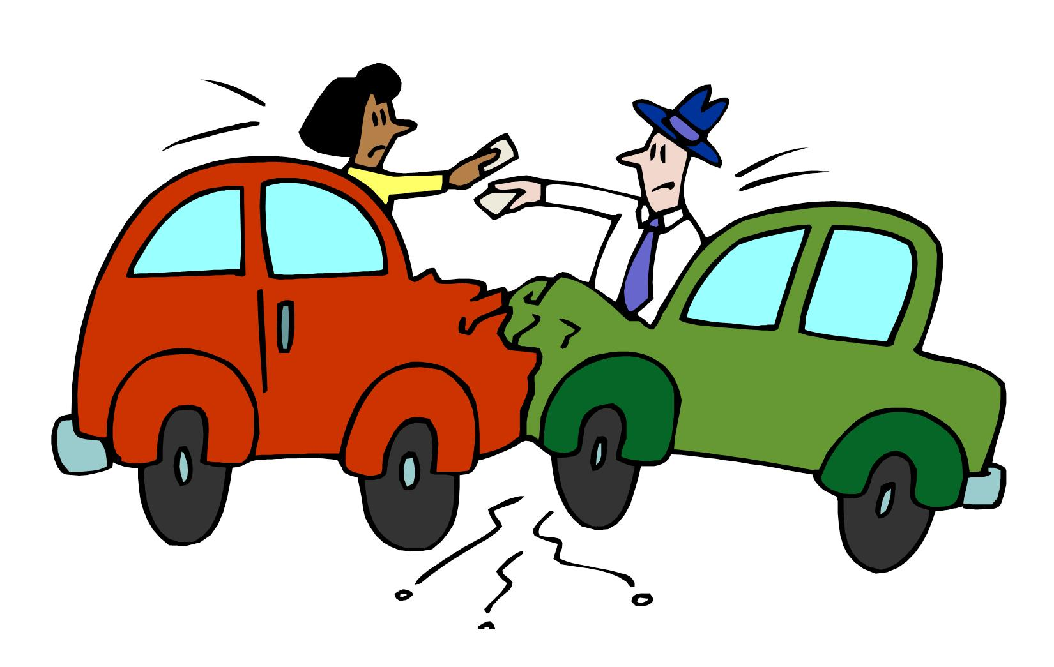
Vehicle Accident Procedure
4. Remove Vehicle Accident Report from glove compartment and fill out
5. Secure names and addresses of all witnesses to the accident
6. Vehicle Accident Report must be sent to Facilities Director

Slide 16
Questions

