Slide 1
Human Resources Presentation
Annual training 2022

Slide 2
PAYCO HCM
This Photo by Unknown Author is licensed under CC BY-SA

Slide 3
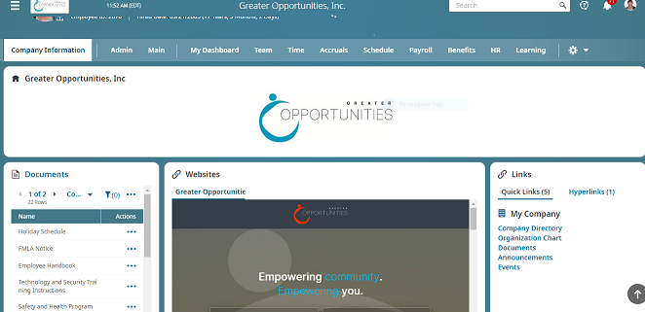
Company Information!!

Slide 4
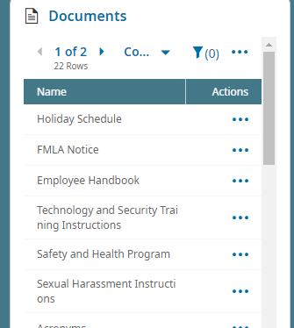
Important Documents
Click on the 3 dots and download

Slide 5
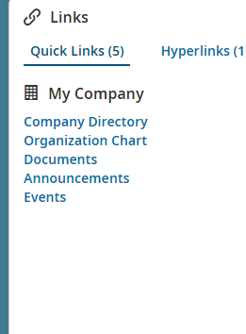
My Company Links
Click on any of the links to review company information

Slide 6
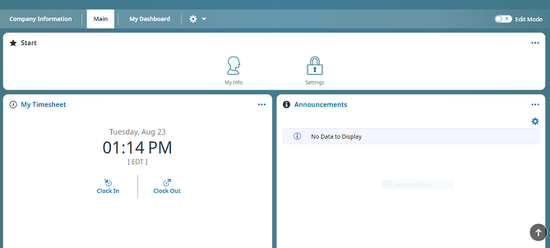
Main Screen
This is the second tab on the home screen

Slide 7
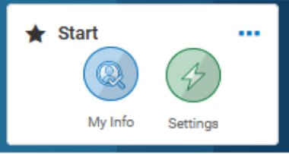
My Info – This section contains links to your personal information:
o My Profile – This is where you can view all your personal information.
o Current Timesheet – View the current pay periods timesheet.
o Historical Timesheets – This section will allow you to view all your historical timesheets.
o Request Time Off – You will come here to request time off, there are further instructions on page 5.
o Time off History/Time Off Calendar – These show the time off you have requested/been approved for/taken.
o My Pay Statements/My W2s – These sections have all your pay statements, W2’s and 1099 info that are available.
My Withholding Forms – If you need to update your Federal/state withholding, the forms can be found here. You can update them electronically and submit them.

Slide 8
Start Widget
You will see My Info and settings

Slide 9
My Mailbox
Includes all to To-Do items and My Pay Information

Slide 10
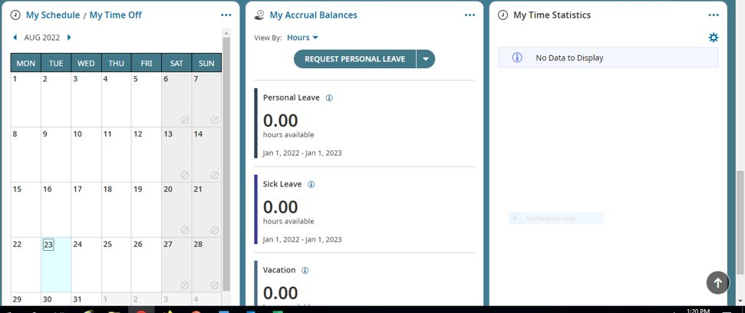
My Schedule and Time Off Calendar – Easy access to approved or pending time off
My Accrual Balances
You can request time off from the tab in Blue

Slide 11
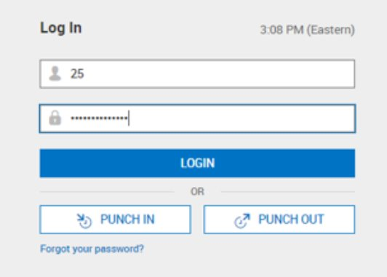
Punching In & Out and Logging In
• To clock in/out or log out, you will go to https://secure.entertimeonline.com/ta/OPPC.clock
• From there, you can simply enter your Username and Password and simply click Punch In or Punch Out and go on with your tasks or you can click Login to log into the system.

Slide 12
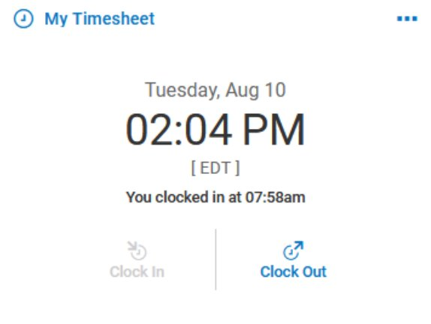
My Timesheet is below the Start widget, and this is where you can clock in/clock out/change departments. You are also able to access your current timesheet by clicking My Clock.

Slide 13
Current Time Sheet
Missing Punches

Slide 14
Timesheet Change Request
In the upper right-hand corner of your time sheet choose Change Request.

Slide 15
Add Time Entry – This option allows you to enter the start and end time of the shift.

Slide 16
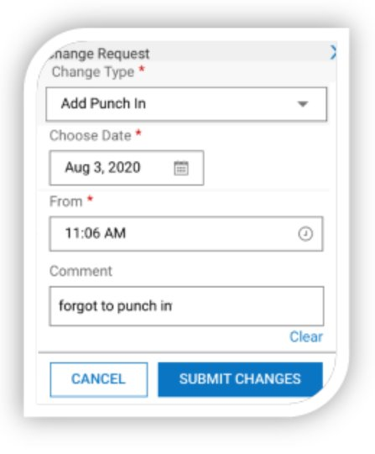
Next, choose what type of request you want to make.
• Add Punch In – With this option you can add in a missed In punch.

Slide 17
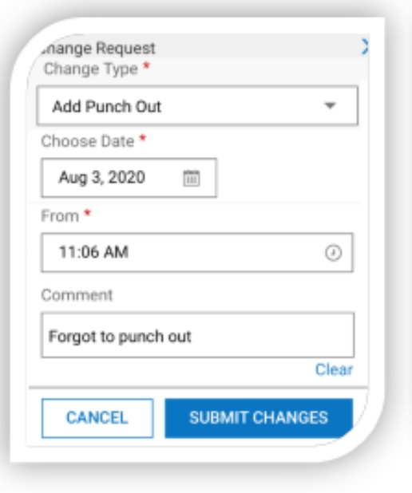
Add Punch Out – With this option you can add in a missed-Out punch

Slide 18
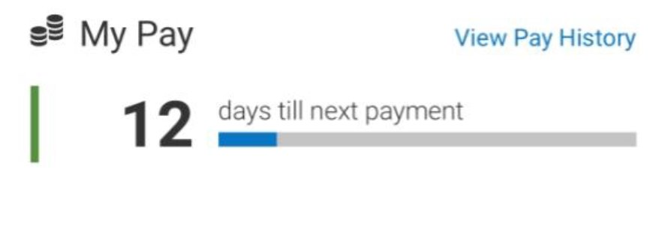
Viewing Pay Statements;
In the My Pay widget, you can see a countdown until your next pay. By tapping the View Pay History hyperlink, you can view your pay history and direct deposits. An e-signature agreement is located here to allow you to agree to receive your pay statement electronically.

Slide 19
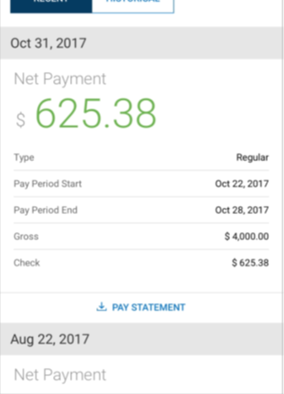
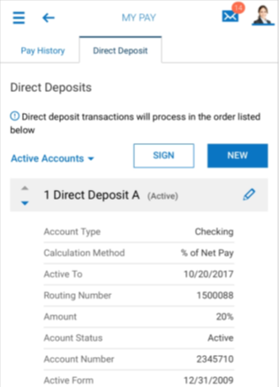
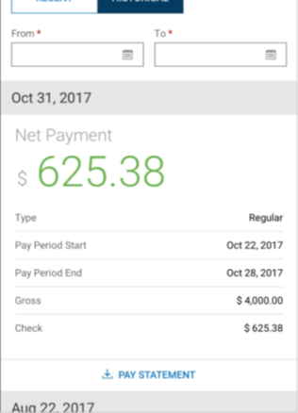
You can tap the download Pay Statement link and the pay statement will display in PDF on a separate page. From there, you can download and save the PDF to your device. To return to your session without having to logout, tap the name of your App at the very top-left of your device.

Slide 20
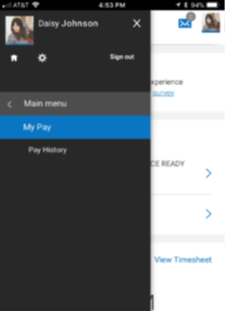
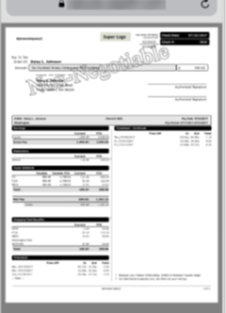
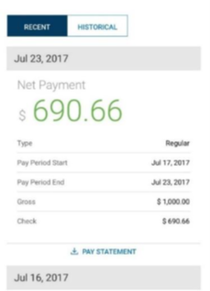
Viewing Past Pay Statements: From the main menu, you can access pay history information from the My Pay menu. Tap the Pay History menu option. The page will default to Recent pay histories and will display your last three (3) most recent pay histories. To view pay statements from further back, click the Historical tab.
You can tap the Pay Statement link and download the full pay statement for that entry. On the Historical tab, you can enter a date range to view the pay statements for that range. Historical pay statements can also be downloaded via the Pay Statement link.

Slide 21
Have a Great Year!!!

